Slide 1

Mathematics in FS2

Slide 2

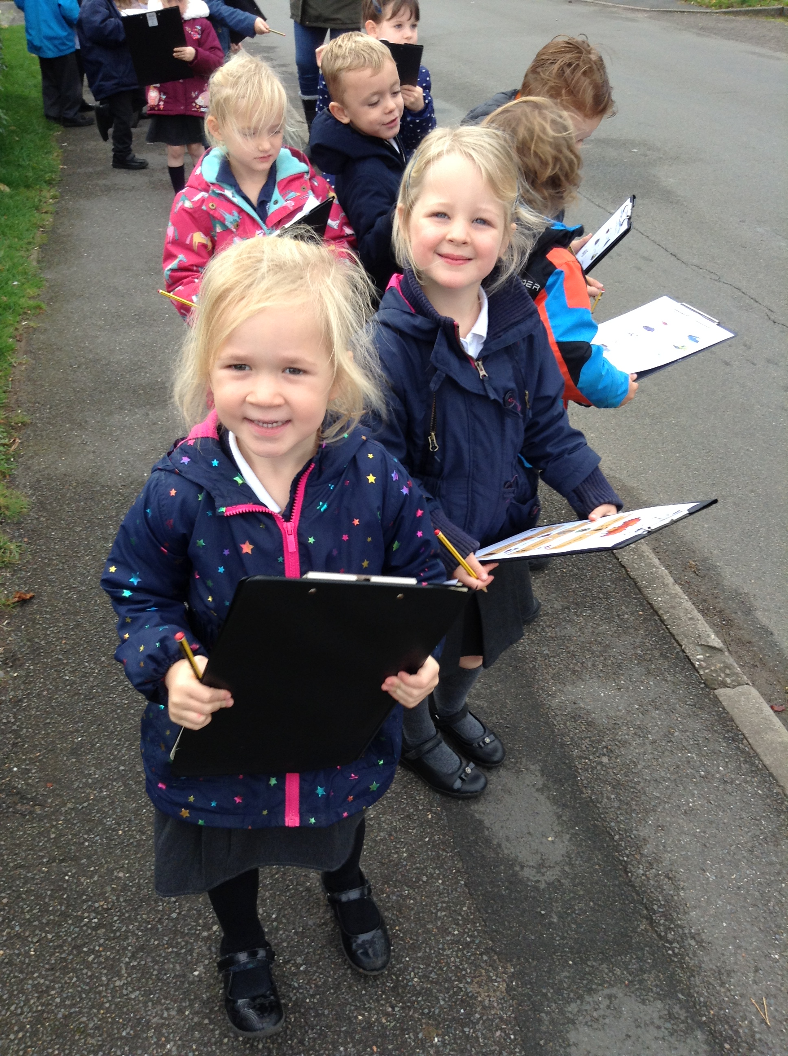

Areas of Mathematics
The Mathematics curriculum is split into two key areas of focus in FS2:
Number
Shape and Measure
Notes:
Briefly discuss before leading on to talk about the curriculum

Slide 3
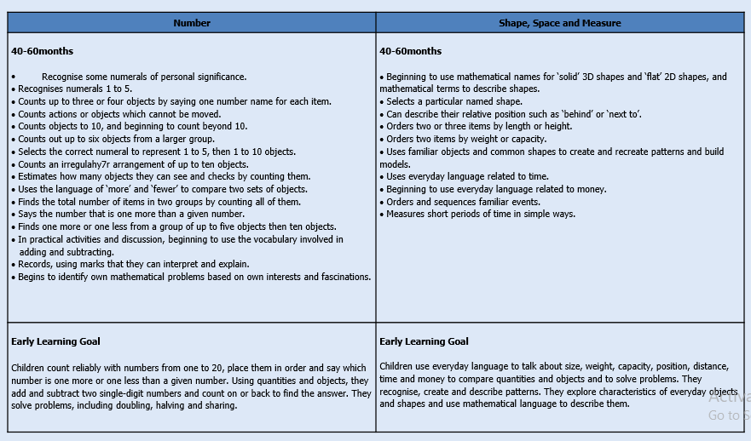
Areas of Mathematics
Notes:
On screen, you can see the school’s curriculum document. This can be accessed via the school webpage.
Within the document, you can see how both number and space and measure are covered in Foundation.

Slide 4
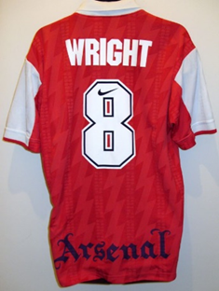
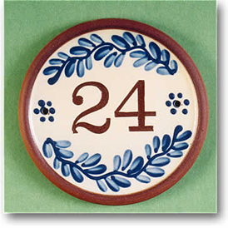
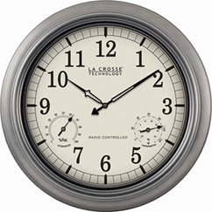
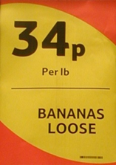
Maths is everywhere!
It is vital to lay secure foundations in early mathematics.
Children need to engage with numbers and to see how to use them in their everyday environment for labelling, quantifying and calculating: we want to help them to develop a better understanding of the world in which they live.
Opportunities to develop and support your child’s mathematical awareness and understanding is in the everyday.
Notes:
So what is the curriculum?
Throughout the EYFS there is a wide range of learning opportunities for the children to experience. These areas will all interlink with each other, reinforcing skills, supporting development.

Slide 5
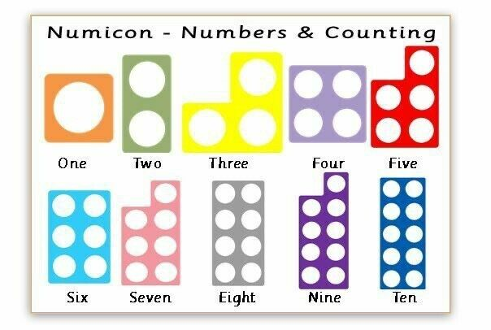
Representing number
Manipulatives and representations can be powerful tools for supporting young children to engage with ideas across many areas of mathematics. They can help children make sense of mathematical concepts, develop visual images, increase engagement and enjoyment, help practitioners see what children understand and provide a bridge to abstract thinking.
Notes:
Children benefit from practical, first hand experiences of moving and interacting with manipulatives to develop mathematical ideas.
It is important that children have opportunities to engage in both free and structured play with manipulatives.
Throughout the EYFS there is a wide range of learning opportunities for the children to experience. These areas will all interlink with each other, reinforcing skills, supporting development.

Slide 6
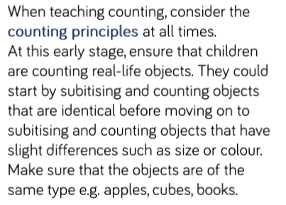
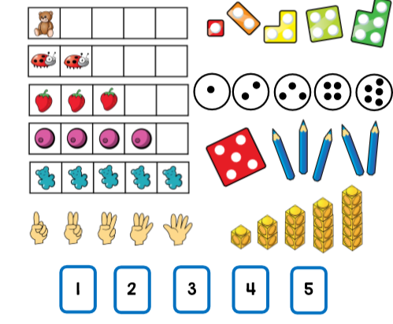
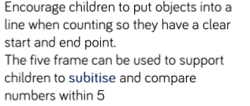
Representing number

Slide 7
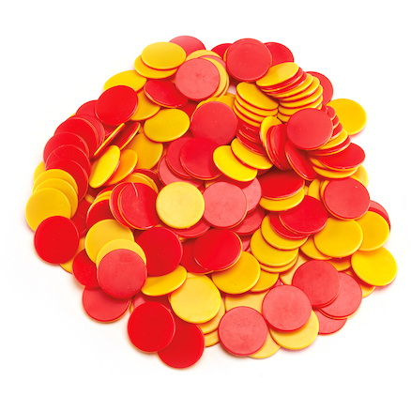
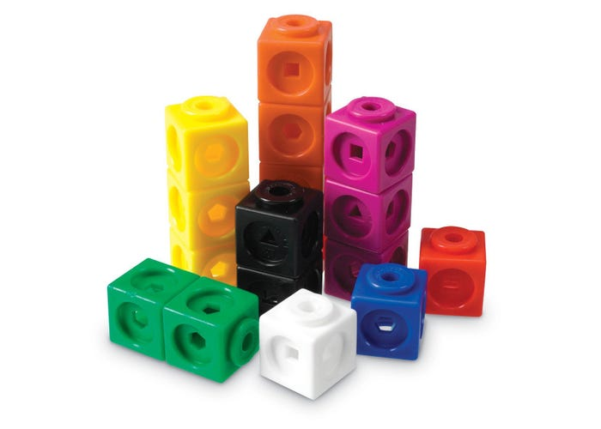

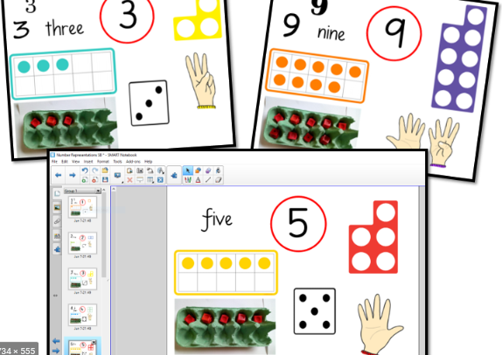
Manipulatives and representations
A manipulative is an object that children or practitioners can interact with and move to represent mathematical ideas. Manipulatives could include everyday objects such as pine cones, buttons, and small toys as well as resources like numicon, interlocking cubes, Cuisenaire rods, Dienes blocks, and building blocks.
A ‘representation’ refers to a particular form in which mathematics is presented. Representations include informal drawings, mathematical symbols, and more formal diagrams, such as a number line or graph.
Notes:
We use a range of manipulatives across foundation to support children's mathematical understanding. Providing children with a variety of options allows them to choose resources that support their learning but also allows them to deepen their understanding.
Numicon is one of the most commonly accessed manipulatives. These can be seen on the screen. Each piece of numicon represents a number 1-10. They can be recognised by their unique colour, shape and size.
They are incredibly versatile and are used in several ways for differing purposes .

Slide 8
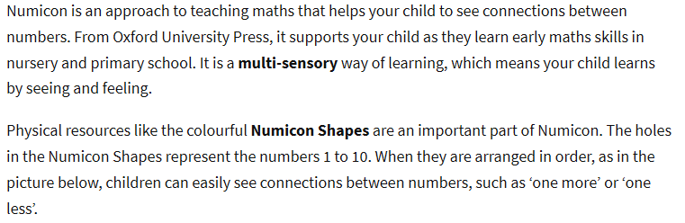
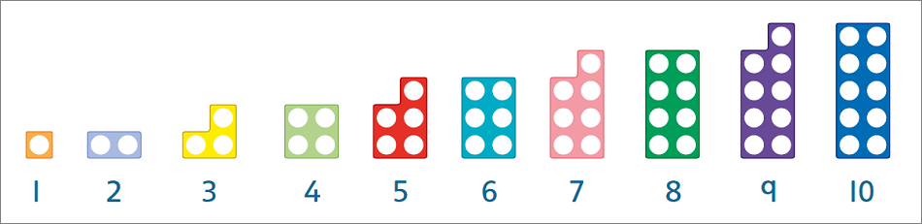
Numicon
https://www.youtube.com/watch?v=Lqf7AssF9Kc

Slide 9
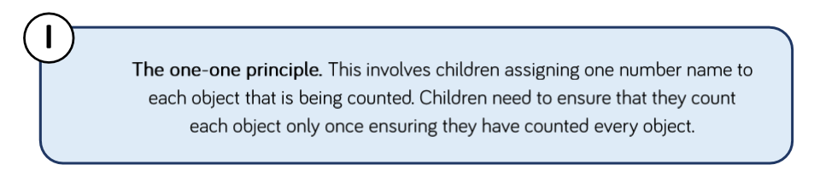
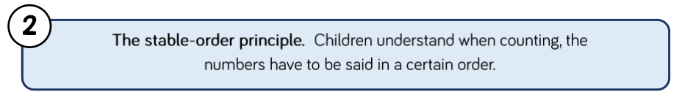
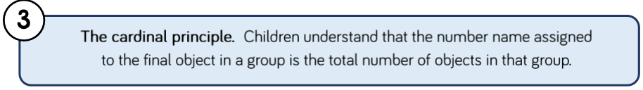
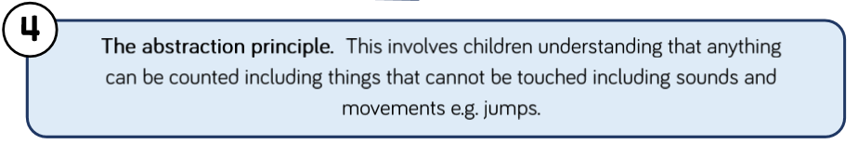
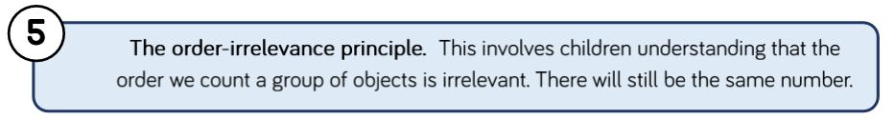
Principles of counting
Notes:
Notes from white rose maths SOL

