Slide 1


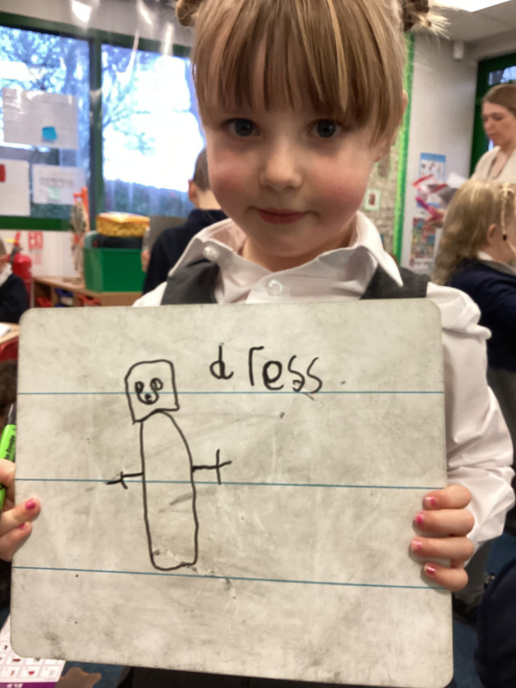



Writing in FS2
D
Muskham Primary
AIm: To explore how a child's writing develops throughout the Foundation Stage.

Slide 2
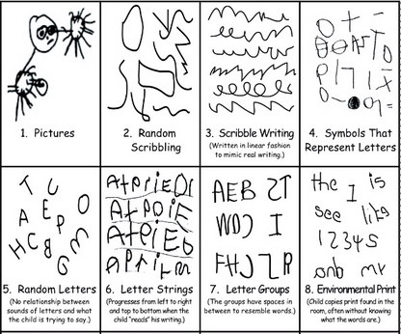

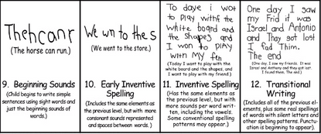
How writing develops throughout the Foundation Stage
When children begin in Foundation, children may be at varying stages of their writing journey.

Slide 3
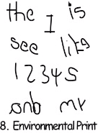
How writing develops throughout the Foundation Stage
Name Writing
When children begin in Foundation,
each child continues to practise spelling and writing their name, building upon the previous learning from their previous educational setting
Children will orginially copy their name from their name tag and then move onto writing their name from memory.

Slide 4
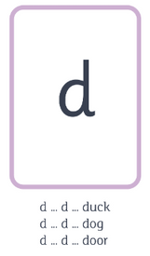
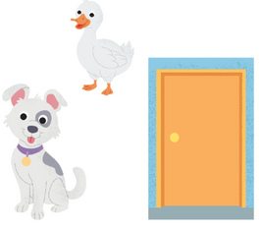
How writing develops throughout the Foundation Stage
Initial sounds
As a school, we introduce our comprehensive phonics scheme, ELS, at the beginning of the Autumn term. Children are introduced to phonemes and graphemes. They are taught how to form these graphemes and have the opportunity to practise them regularly.
At this writing stage, we see children use just the initial sound to represent a word.

Slide 5

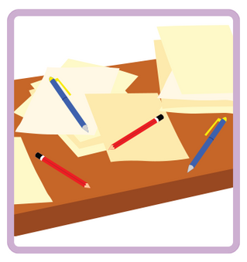

How writing develops throughout the Foundation Stage
CVC words
As your child progresses through the Autumn term, they will have learnt several phonemes and graphemes. At this point, we have enough sounds to be able to form simple CVC words (consonant, vowel, consonant).
mess

Slide 6
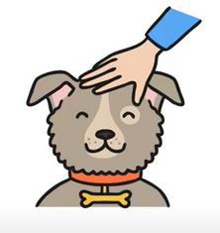
How writing develops throughout the Foundation Stage
Captions
Once children have grasped segmenting and blending CVC words, they will begin to build captions.
a mess
or
mess and pens
pat a dog

Slide 7

How writing develops throughout the Foundation Stage
Simple sentences
In order to write a sentence, children must be aware of what makes their writing a sentence rather than a caption.
This is where Rainbow Grammar is introduced as a tool to support sentence construction.
The man pats a dog.

Slide 8
How writing develops throughout the Foundation Stage
Simple sentences
The man pats a dog.
Rainbow Grammar, in FS2, involves 3 colours:
Green: Who are we talking about?
Orange: What is happening?
Red: Stop.

Slide 9
How writing develops throughout the Foundation Stage
Simple sentences
The desk is a mess.
Rainbow Grammar, in FS2, involves 3 colours:
Green: Who are we talking about?
Orange: What is happening?
Red: Stop.

