Slide 1
Muskham Primary School
Phonics

Slide 2
What is Phonics?
Our language system consists of 26 letters of the alphabet which are used to form the 44 phonemes.
These phonemes can be written in over 120 combinations – for example, i-e side, ie pie, igh high, y fly.
We use the Essential Letters and Sounds programme.

Slide 3
Why do we teach phonics?
Skills for life – Reading and Writing.
This allows children to access a wealth of knowledge and to succeed in life.

Slide 4
Phoneme
The smallest unit of sound in a word.
For example ‘sun’ has 3, ‘chair’ has 2.
There are 44 phonemes that we teach.

Slide 5

The 44 phonemes
/b/ | /d/ | /f/ | /g/ | /h/ | /j/ | /k/ | /l/ | /m/ | /n/ | /ng/
/p/ | /r/ | /s/ | /t/ | /v/ | /w/ | /y/ | /z/ | /th/ | /th/ | /ch/
/sh/ | /zh/ | /a/ | /e/ | /i/ | /o/ | /u/ | /ae/ | /ee/ | /ie/ | /oe/
/ue/ | /oo/ | /ar/ | /ur/ | /au/ | /er/ | /ow/ | /oi/ | /air/ | /ear/ | /ure/

Slide 6
Grapheme
The written form of the phoneme. It is what we write on paper or see on resources. The number of graphemes corresponds to the number of phonemes.
A grapheme can me made up of a different numbers of letters. For example, ‘ai’ has 2 and ‘ear’ has 3.

Slide 7
Digraph
Two letters together that make one sound.
For example, ‘ck’, ‘ee’ and ‘ar’.
You can have consonant digraphs like ‘sh’ or ‘ch’
You can have vowel digraphs like ‘ai’ or ‘oo’

Slide 8
Trigraph
Three letters together that make one sound.
For example, ‘igh’, ‘ear’ and ‘air’
These are learnt in phase 3.

Slide 9
Split vowel digraph
This is when a digraph like ‘ie’ has been split and a consonant has been placed in the middle.
It still makes the ‘ie’ phoneme.
There are 5 to learn: a-e, i-e, e-e, o-e and u-e

Slide 10
Pure sounds
Pronouncing the sounds of letters and combination of letters correctly. Avoid the ‘uh’ at the end of the sound.
So, mmmm not ‘muh’

Slide 11
Blending
Your child hears a series of sounds and they are able to blend those sounds together to make a whole word.
You say
c-a-t
and they ‘blend’ them in the order in which they are written to pronounce the word ‘cat’

Slide 12
Segmenting
The opposite of blending.
Children break up the word into it’s component sounds. We use our ‘robot arms’ or ‘phonics fingers’ to count the number of sounds in the word.
Used for writing.

Slide 13
Decodable words
Being able to ‘sound’ out the word into it’s component parts.

Slide 14
Harder to read words
Words that are not phonetically decodable. eg was, the, I
Children need to learn these words by sight
,

Slide 15




Getting all children to
read well, quickly.

Slide 16




What is ELS?
Essential Letters and Sounds (ELS) is our chosen phonics programme
Children will experience the joy of books and language whilst rapidly acquiring the skills they need to become fluent independent readers and writers.
© Oxford University Press 2021
Notes:
We use phonemes and graphemes to teach children the code of our language.
English is one of the most challenging languages to learn as there are so many ways to spell the sounds of our language.
We teach children to decode words – by identifying each of the written sounds within the word before blending them together to read the word. This is a challenging process for children to learn and takes time to master. When they are able to decode and blend to....

Slide 17
How do we teach phonics?
We use a simple, consistent approach to teaching phonics.
We have mnemonics and rhymes to support learning and recall
We teach phonics every single day from the first days of Reception
© Oxford University Press 2021
Notes:
Phonics teaches the link between the spoken sounds of our language and the written version of that sound – the code of our language.
As systematic synthetic phonics programme breaks this down into tiny steps for children to piece together which allows them to decode to read and then spell using the sound to spelling correspondences they have learnt.
We use a simple, consistent approach to teaching phonics.
Your child will experience the same classroom routines within each lesson which reduces cognitive load and maximises the chances of success.
All children are supported within the lesson to use their new phonic knowledge independently.
In every single ELS lesson, your child will make the direct application to reading.

Slide 18
How do we teach phonics?
Phonics throughout the day to review new sounds & graphemes taught
Lots of opportunities for oral blending- /c/ /oa/ /t/
© Oxford University Press 2021

Slide 19
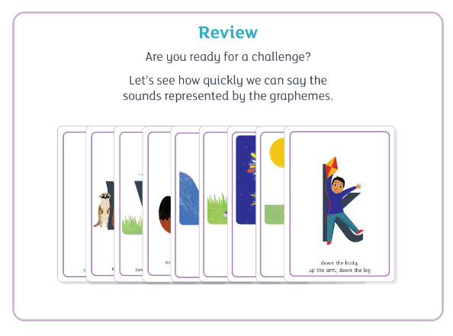
How do we teach phonics?
© Oxford University Press 2021
Notes:
In ELS we do not ask children questions before we have taught them.
For example, when teaching a new sound, rather than asking children if they know any words with the sound in - we give the children 3 words that contain that sound. You can try this with your children at home.

Slide 20
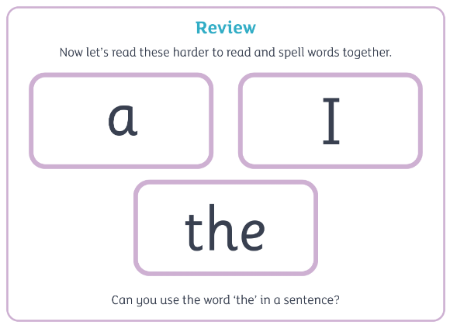
How do we teach phonics?
© Oxford University Press 2021
Notes:
The new teaching is always highlighted so that it is easy for all children to see where the new GPC they have been taught is located. First we say the new sound, then we find it in the word. Finally, we decode and blend. Children have as much or as little support as needed. We want every child to feel confident and successful at each step.

Slide 21
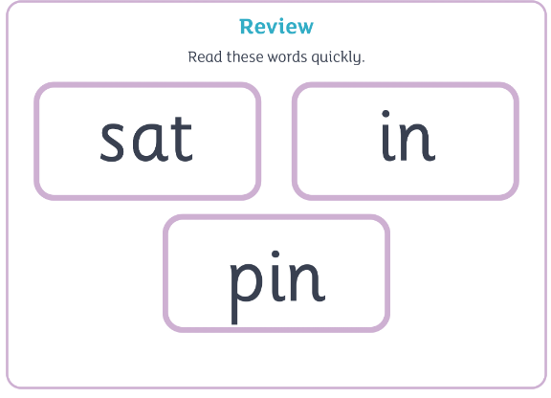
How do we teach phonics?
© Oxford University Press 2021
Notes:
In the beginning of Reception, we learn to read words and then captions, phrases and sentences. As children learn more of the code of our language we are able to build more complex sentences for them to read.
Here we have a sentence from Year One. We build the code for the children and as this knowledge grows we are able to read more complex sentences.

Slide 22
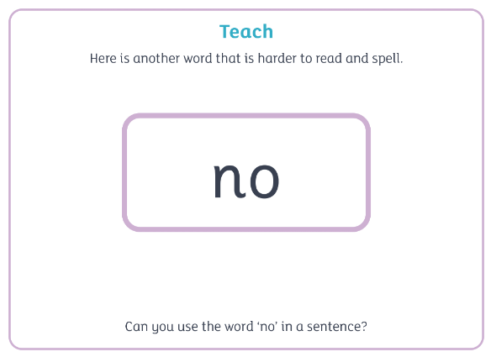
How do we teach phonics?
© Oxford University Press 2021
Notes:
In the beginning of Reception, we learn to read words and then captions, phrases and sentences. As children learn more of the code of our language we are able to build more complex sentences for them to read.
Here we have a sentence from Year One. We build the code for the children and as this knowledge grows we are able to read more complex sentences.

Slide 23
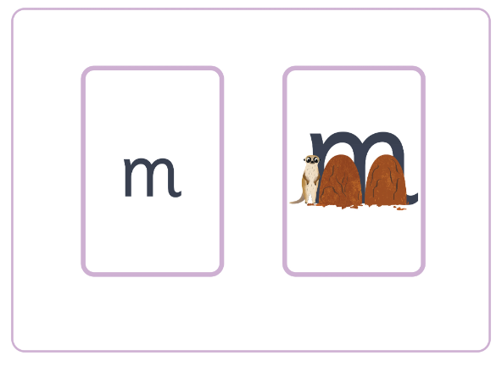
How do we teach phonics?
© Oxford University Press 2021
Notes:
In the beginning of Reception, we learn to read words and then captions, phrases and sentences. As children learn more of the code of our language we are able to build more complex sentences for them to read.
Here we have a sentence from Year One. We build the code for the children and as this knowledge grows we are able to read more complex sentences.

Slide 24
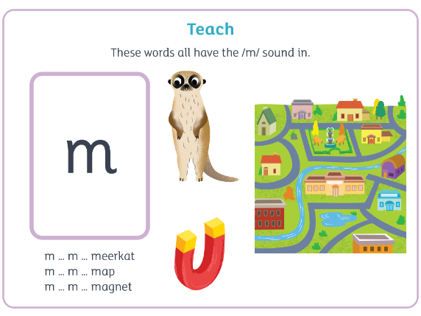
How do we teach phonics?
© Oxford University Press 2021
Notes:
In the beginning of Reception, we learn to read words and then captions, phrases and sentences. As children learn more of the code of our language we are able to build more complex sentences for them to read.
Here we have a sentence from Year One. We build the code for the children and as this knowledge grows we are able to read more complex sentences.

Slide 25
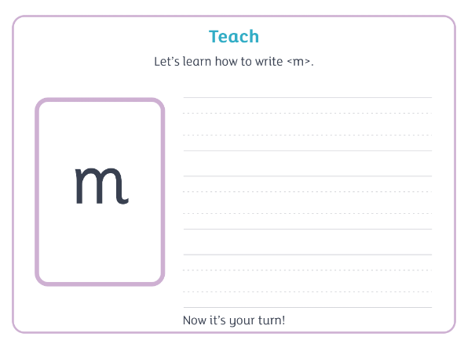
How do we teach phonics?
© Oxford University Press 2021
Notes:
In the beginning of Reception, we learn to read words and then captions, phrases and sentences. As children learn more of the code of our language we are able to build more complex sentences for them to read.
Here we have a sentence from Year One. We build the code for the children and as this knowledge grows we are able to read more complex sentences.

Slide 26
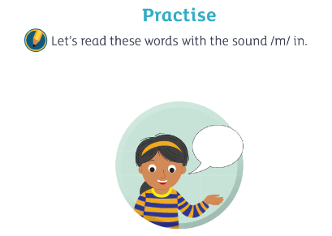

How do we teach phonics?
© Oxford University Press 2021
Notes:
In the beginning of Reception, we learn to read words and then captions, phrases and sentences. As children learn more of the code of our language we are able to build more complex sentences for them to read.
Here we have a sentence from Year One. We build the code for the children and as this knowledge grows we are able to read more complex sentences.

Slide 27
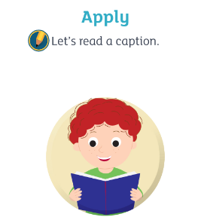

How do we teach phonics?
© Oxford University Press 2021
Notes:
In the beginning of Reception, we learn to read words and then captions, phrases and sentences. As children learn more of the code of our language we are able to build more complex sentences for them to read.
Here we have a sentence from Year One. We build the code for the children and as this knowledge grows we are able to read more complex sentences.

Slide 28
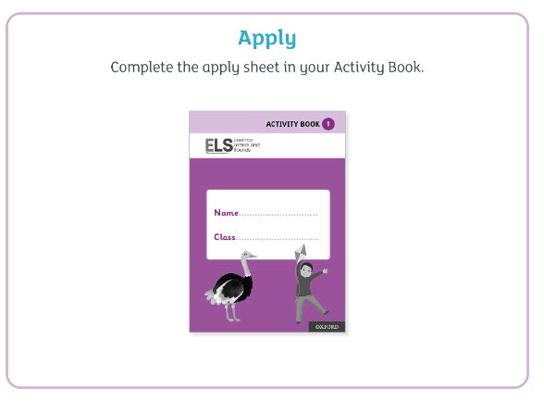
How do we teach phonics?
© Oxford University Press 2021
Notes:
In the beginning of Reception, we learn to read words and then captions, phrases and sentences. As children learn more of the code of our language we are able to build more complex sentences for them to read.
Here we have a sentence from Year One. We build the code for the children and as this knowledge grows we are able to read more complex sentences.

Slide 29

ELS Progression
© Oxford University Press 2021
Notes:
In Reception your children will learn all the single letter sounds and begin to learn diagraphs and trigraphs.

Slide 30

ELS Progression
© Oxford University Press 2021

Slide 31
Supporting your child with reading at home
Only 1 in 3 children are read a bedtime story night
Reading a bedtime story every night to your child improves their outcomes
If your child views themselves as a ‘good reader’ when they leave Primary School they are more likely to earn a higher salary in their 40s.
© Oxford University Press 2021
Notes:
Reading until they are 3 improves outcomes in YR, reading until they are 5 improves outcomes in Y6 and reading until they are 8 improves outcomes aged 16!
Children who achieved the Early Learning goals for literacy are 11 times more likely to achieve the expected outcomes in Maths at the end of KS2. Reading underpins everything.
We want all our children to leave primary school able to read well and confidently – you can support us in this journey.

Slide 32
Supporting your child with reading at home
Children are only reading from books that are entirely decodable
Your child should be able to read their book confidently
We only use pure sounds when decoding words (no ‘uh’ after the sound)
We want them to practise reading their book 5 times across the week working on these skills:
decode
fluency
expression
© Oxford University Press 2021
Notes:
We want children to only have success when learning to read
Decode – explain this meaning
Fluency – recognising the sound for spelling within the word and blending fluently
expression – model this for the children in school, when reading at home we want children to start to think about expression and intonation. For example, if someone is asking a question let’s get the children to make their voices sound like they are asking a question.

Slide 33
Supporting your child with reading at home
We want children to create a strong orthographic map. This means that they learn sounds spelt by the letters or groups of letters in each word.
To read fluently, or well, we need a strong orthographic map.
To consistently recognise that the <ea> in bread spells /e/ we need to read it at least 4 times. This means we need to read the word many times to build fluency for reading.
© Oxford University Press 2021

Slide 34

Supporting your child with writing at home
You can use the spelling sequence with your children at home to support them with their writing.
Let’s try this with the word: rain
We also practise saying our sentences before we write them to make sure we write the sentence we have planned and to ensure it makes sense!
© Oxford University Press 2021
Notes:
Use the spelling sequence to model rain
Say the word – warm it up – stretch the word – robot talk the word – blend the word – count the sounds within the word – say the word
You can talk about how you support your children with their writing in school.

Slide 35
Reading at Home
A new book will be issued every Friday in line with the phonics teaching of the week
An E-book will also be available – details were sent out today via email on how to access these.
Recommended Reads

Slide 36
Information
Lets take a look at the school website:
https://www.muskham.notts.sch.uk/
Any Questions?

